Slide 1


Proof of Concept (POC) on Issue Management
For
Power Grid Corporation
Punya Palit
Pinnacle Systems

Slide 2
AGENDA
POC Scope discussion
Display of all issues in ROW (MAP and Aerial View)
MAP and Aerial Views of Transmission Rows
MAP and Aerial Views of Transmission Lines
MAP and Aerial Views of Transmission Sub-Stations
Filtering on the basis of status of an issue(Pending, In Progress, Closed, Completed)
Displaying Issues with specific Filters (Company, Issue Type, Projects)
Displaying Issue Details with and without Various Filters(Will require similar data for POC)
Displaying and Assigning an Issue to a vendor/crew
Data Requirement from PGCIL

Slide 3
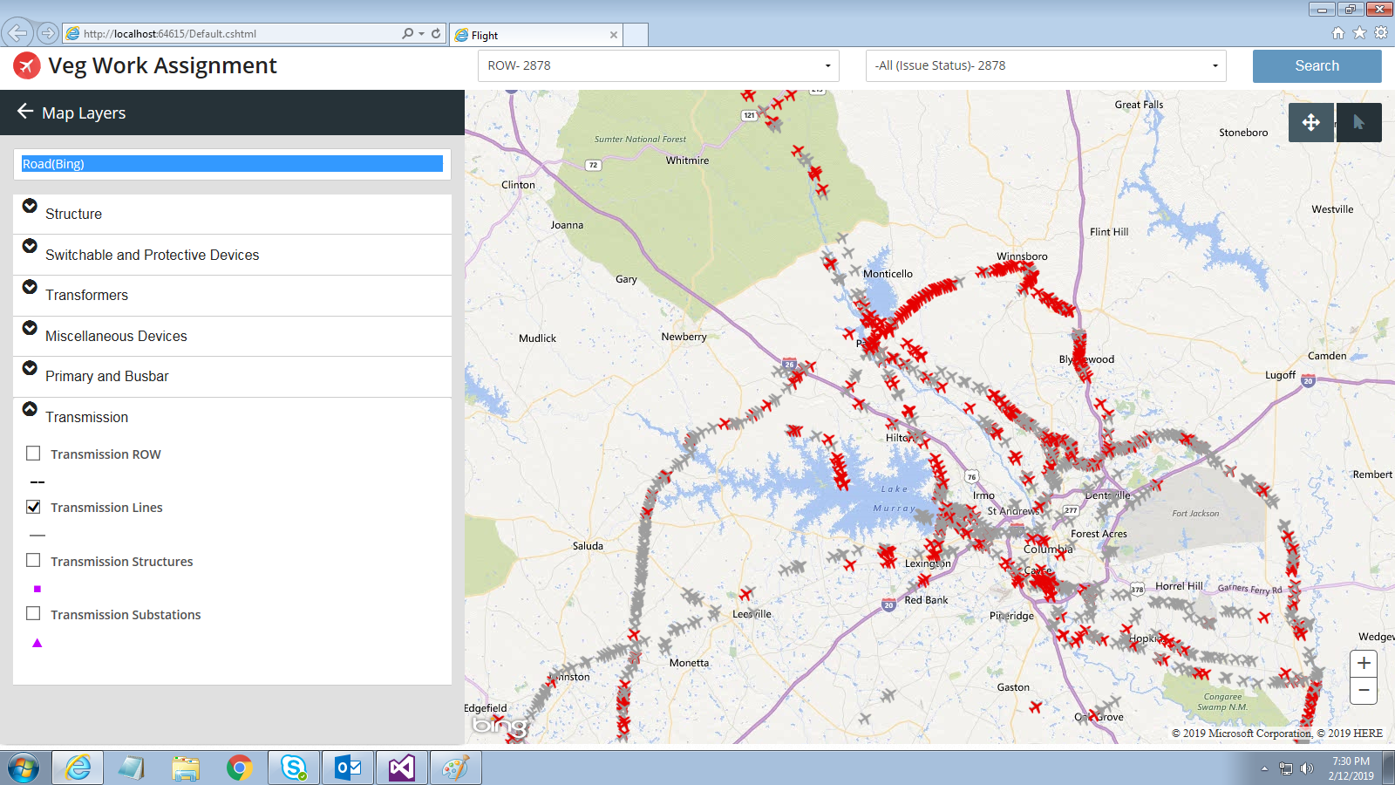
MAP View of all ROW issues (Pending, In Progress, Completed, Closed)

Slide 4
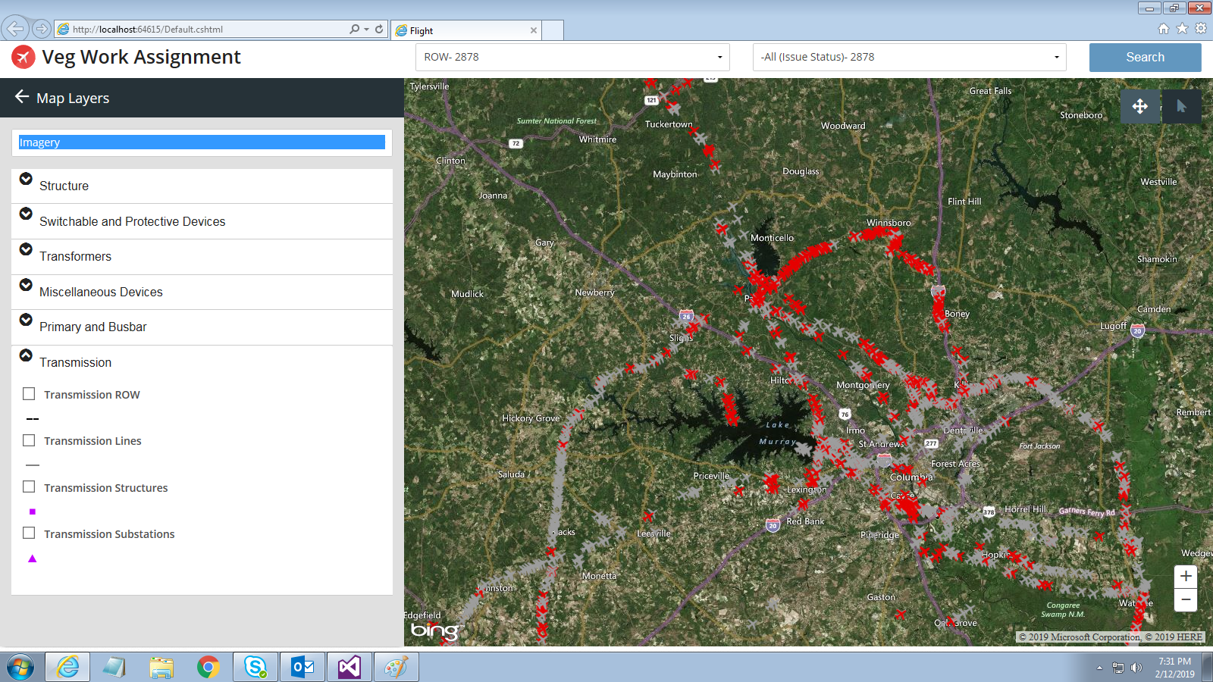
Aerial View of all ROW issues (Pending, In Progress, Completed, Closed)

Slide 5
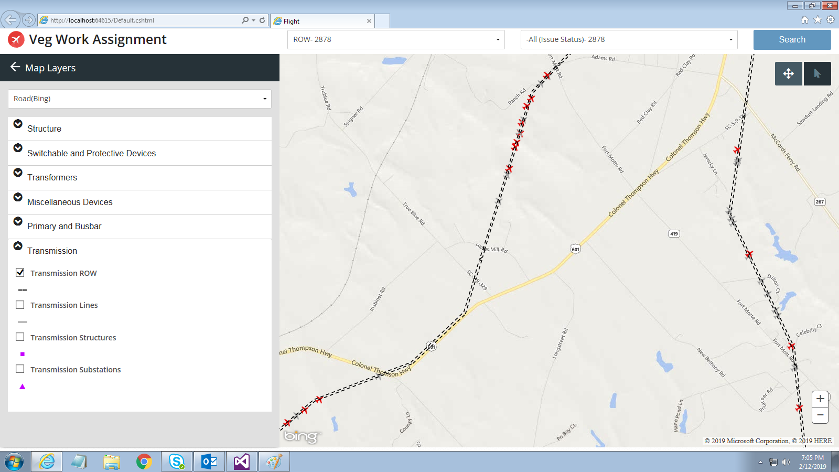
MAP View of Transmission Row (Right of Way)

Slide 6
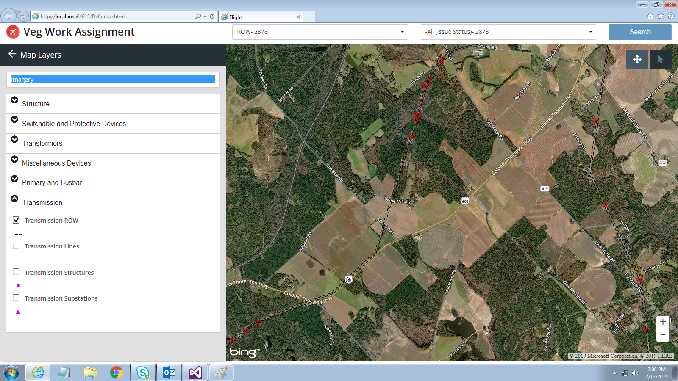
Aerial view of Transmission row

Slide 7
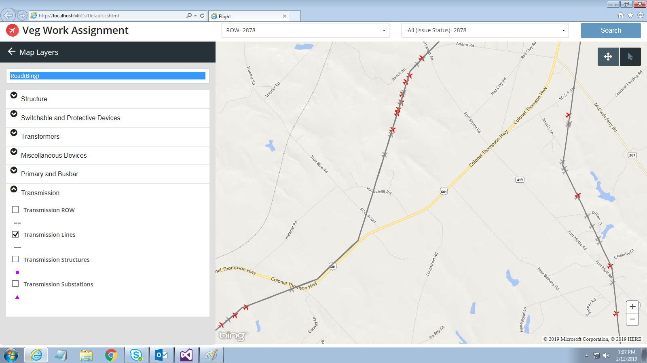
MAP View of Transmission Line

Slide 8
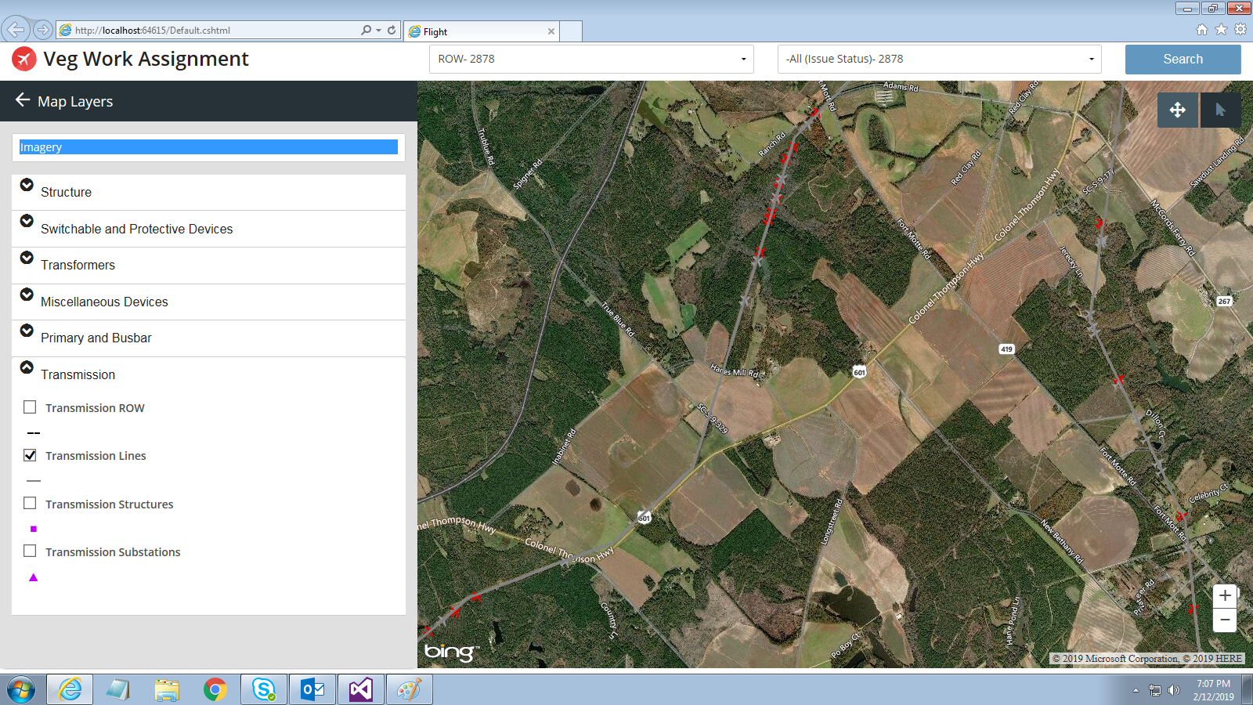
Aerial View of Transmission Line

Slide 9
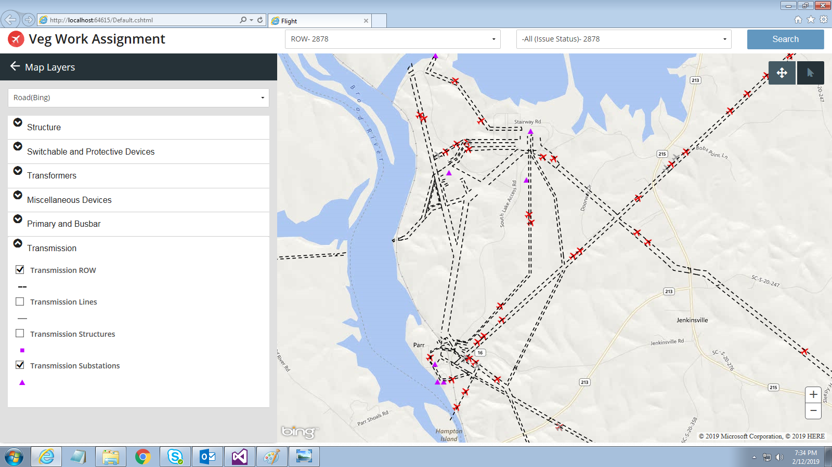
MAP view with Transmission Substations

Slide 10
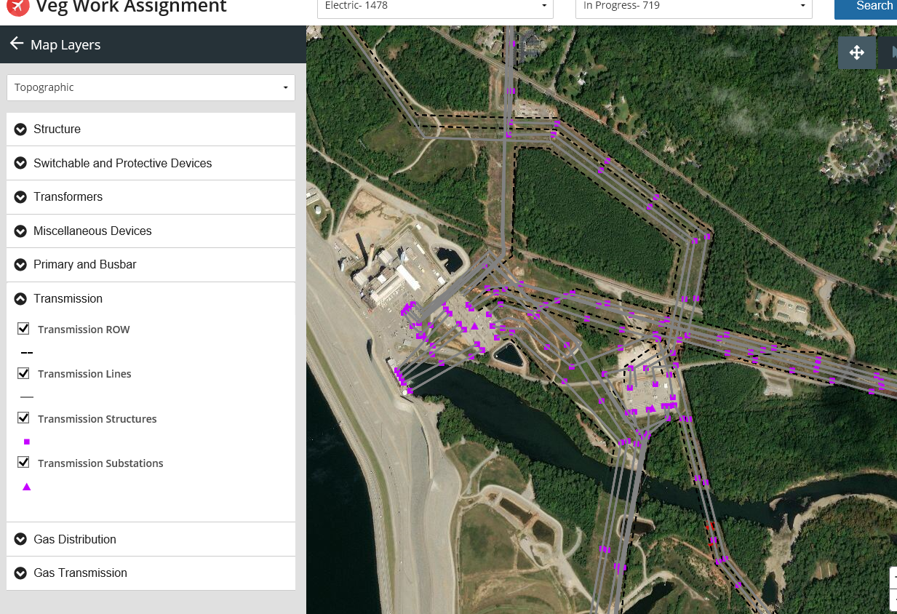
Aerial View of Transmission sub-stations

Slide 11
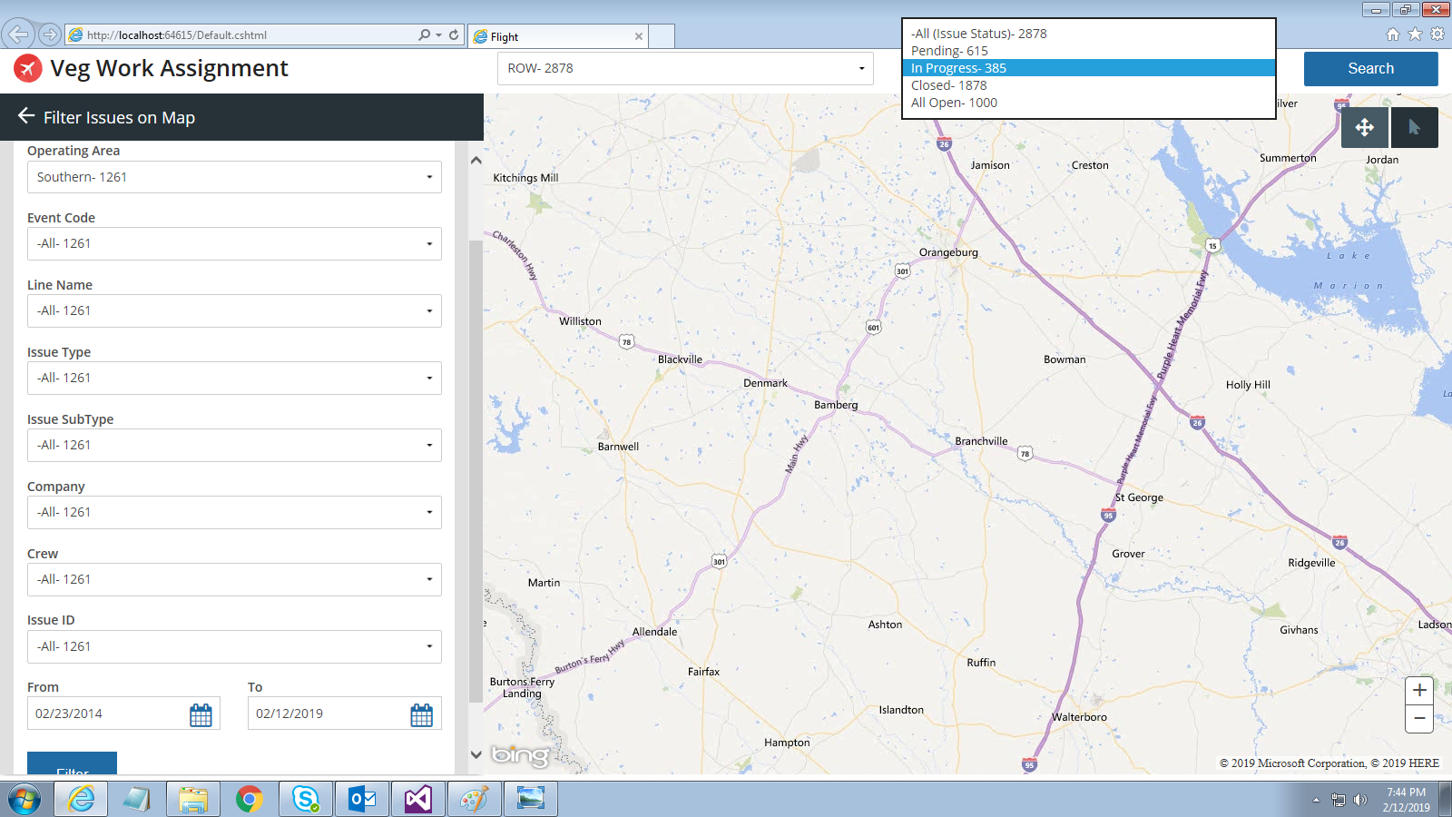
Filtering on different status of the Issues (Pending, In Progress, Closed, Completed)

Slide 12
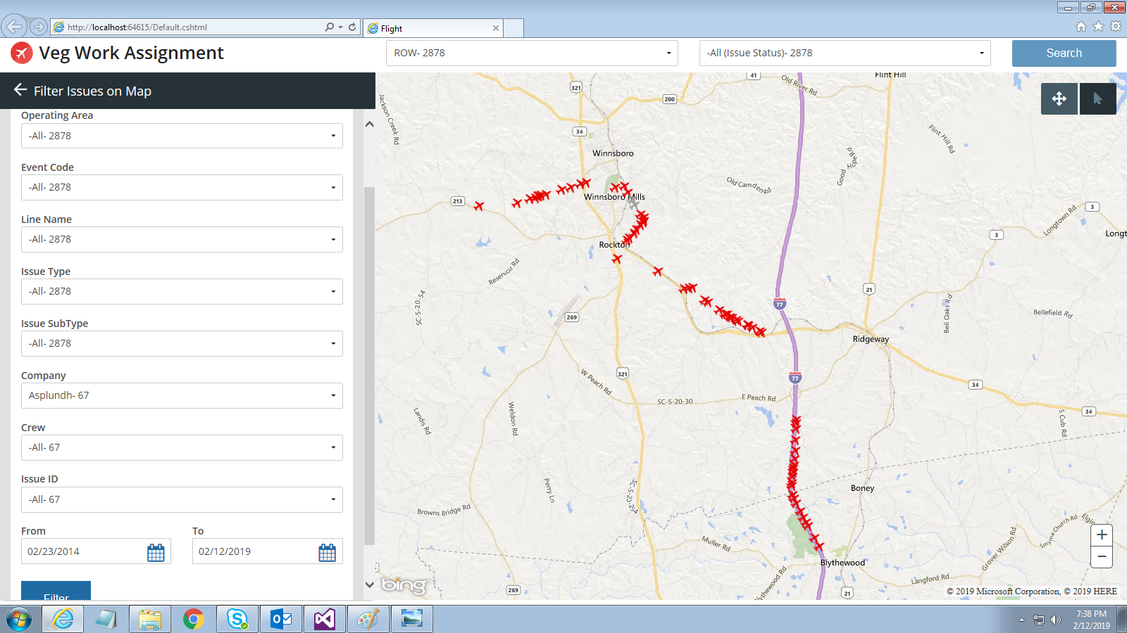
MAP View of issues which can be displayed using various filters (A specific vendor’s information is selected in this screenshot)

Slide 13
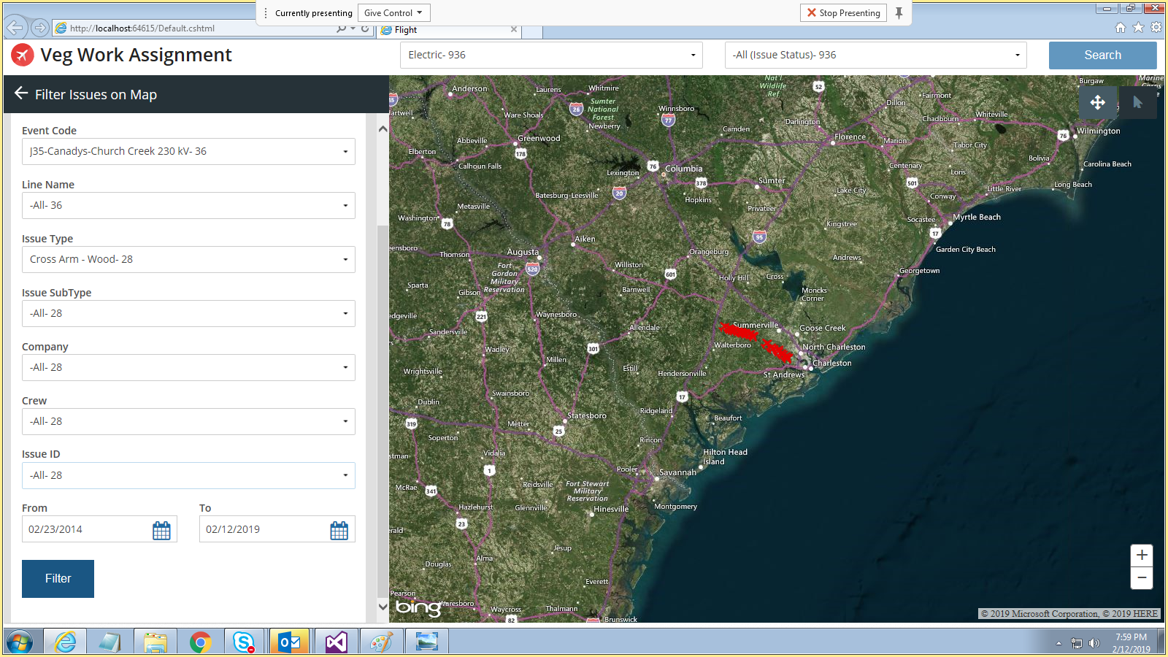
Filtering Data using Issue Types (Aerial View)

Slide 14
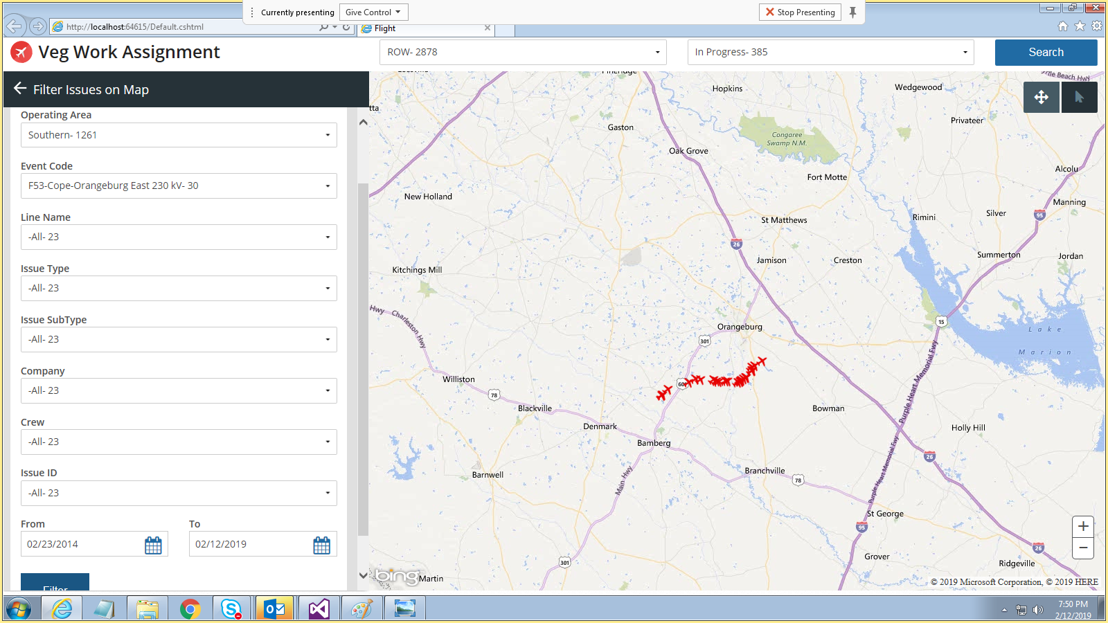
Displaying issues filtering by specific project

Slide 15
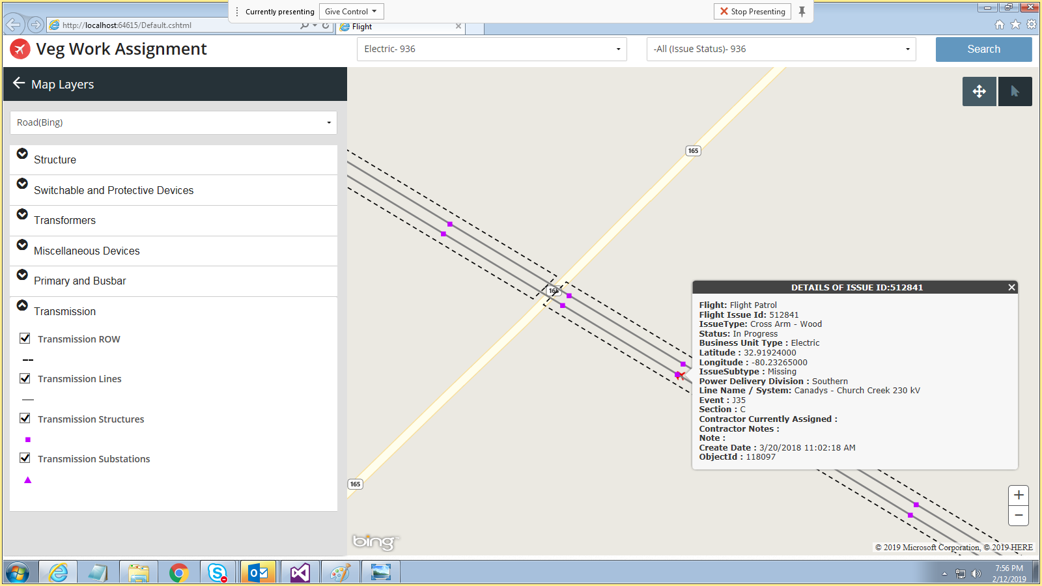
Displaying Issue specific Data (We will request similar data from PGCIL for this POC)

Slide 16
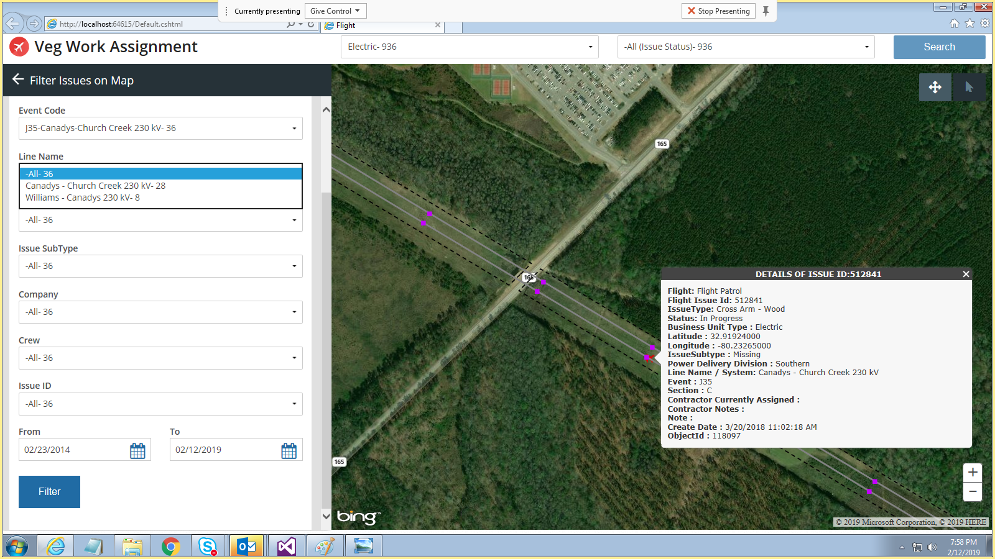
Aerial View of issue details filtered by Line Name (Each project has multiple Lines)

Slide 17
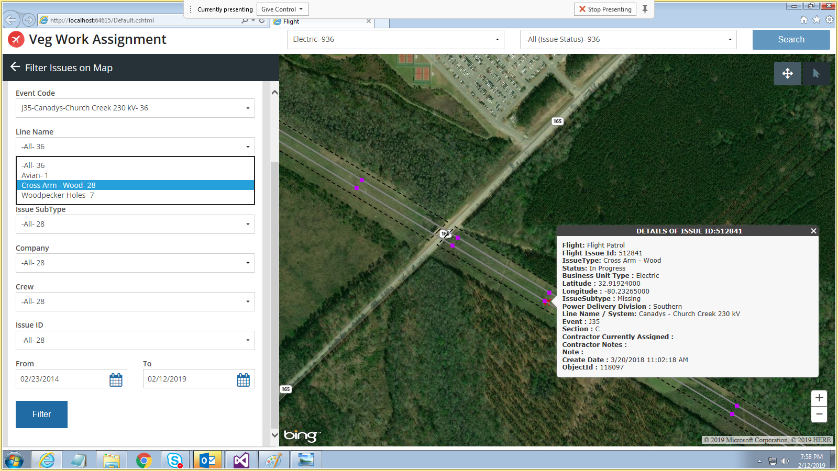
Aerial View of issue details filtered by Issue Type

Slide 18
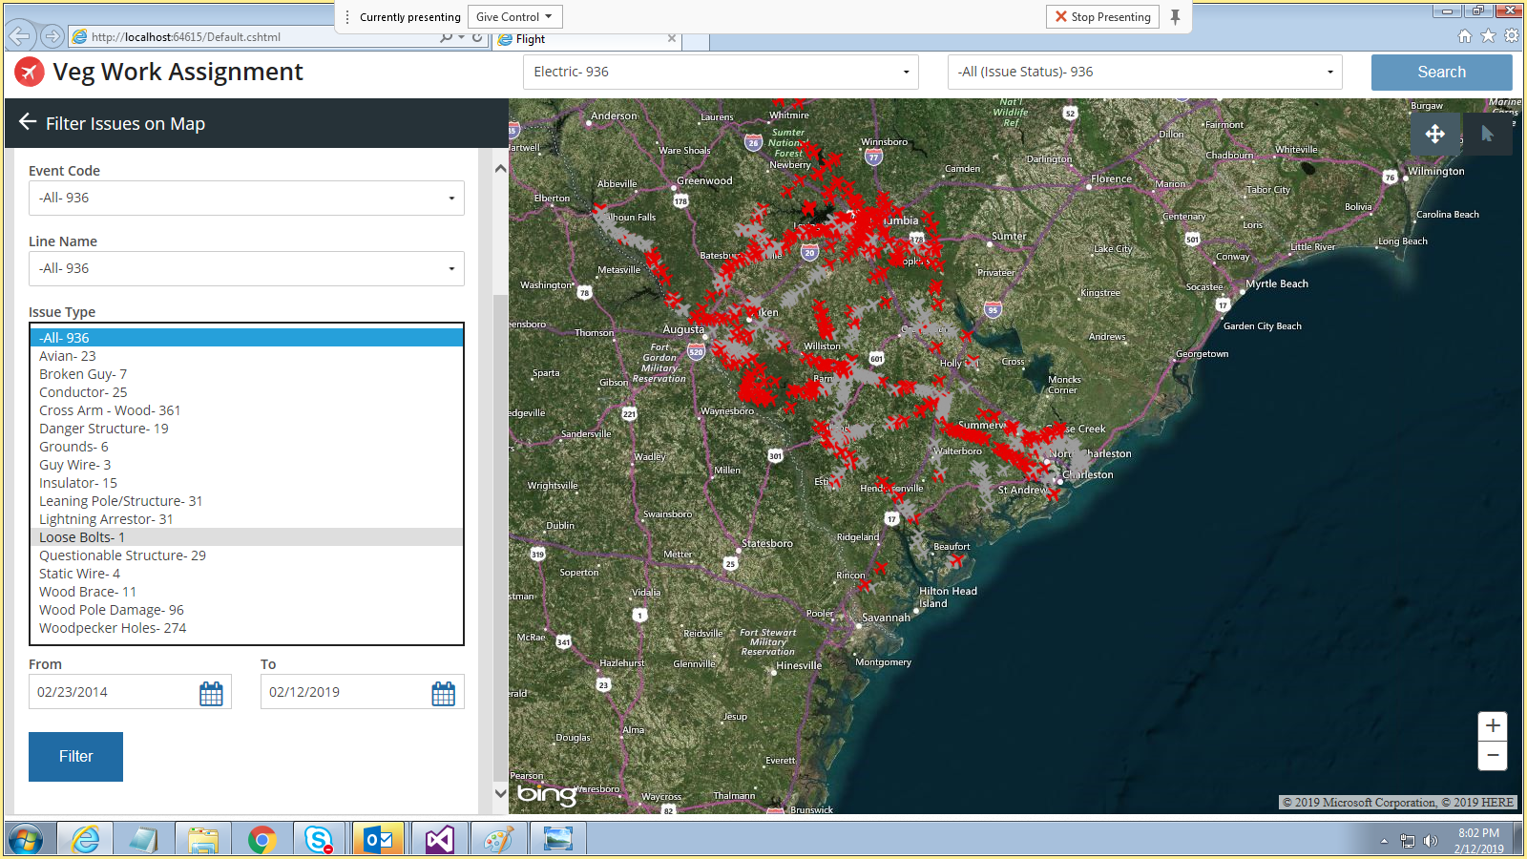
Aerial View of issue details filtered by Issue Sub types (Electric)

Slide 19
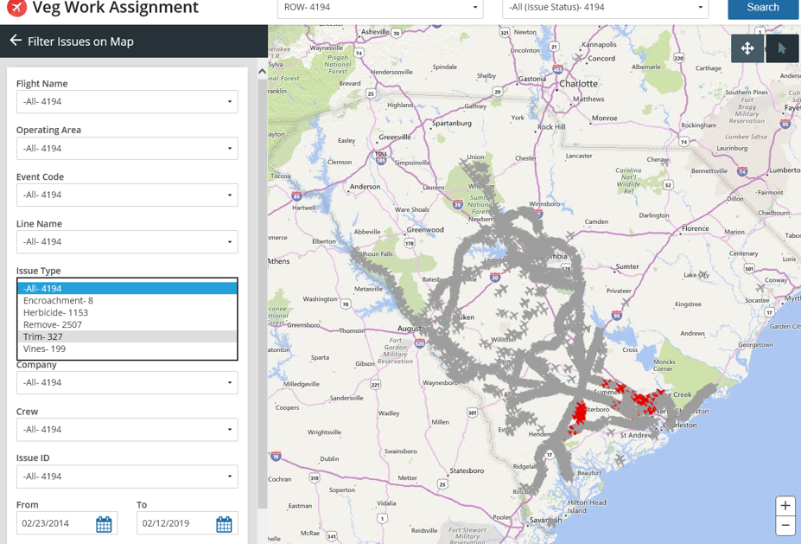
Aerial View of issue details filtered by Issue Sub types (ROW) – Here we are displaying encroachments

Slide 20
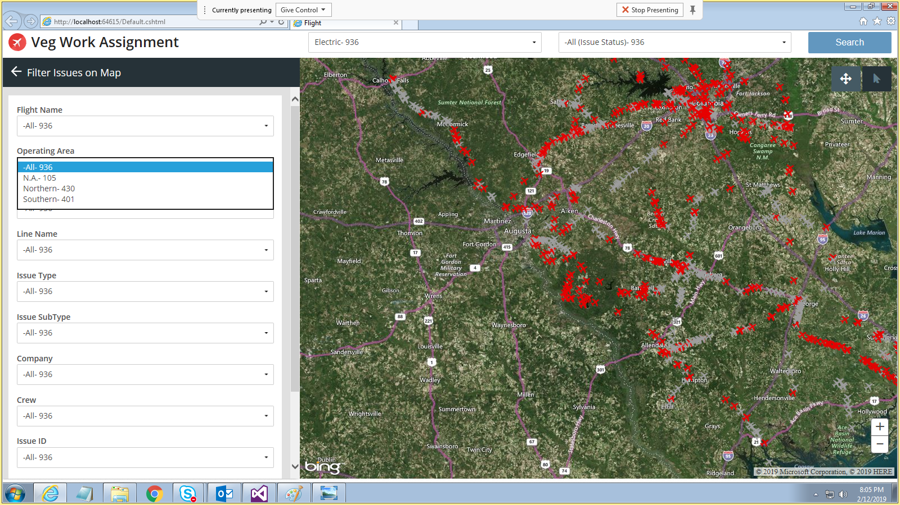
Filtering Issues on different operating area

Slide 21
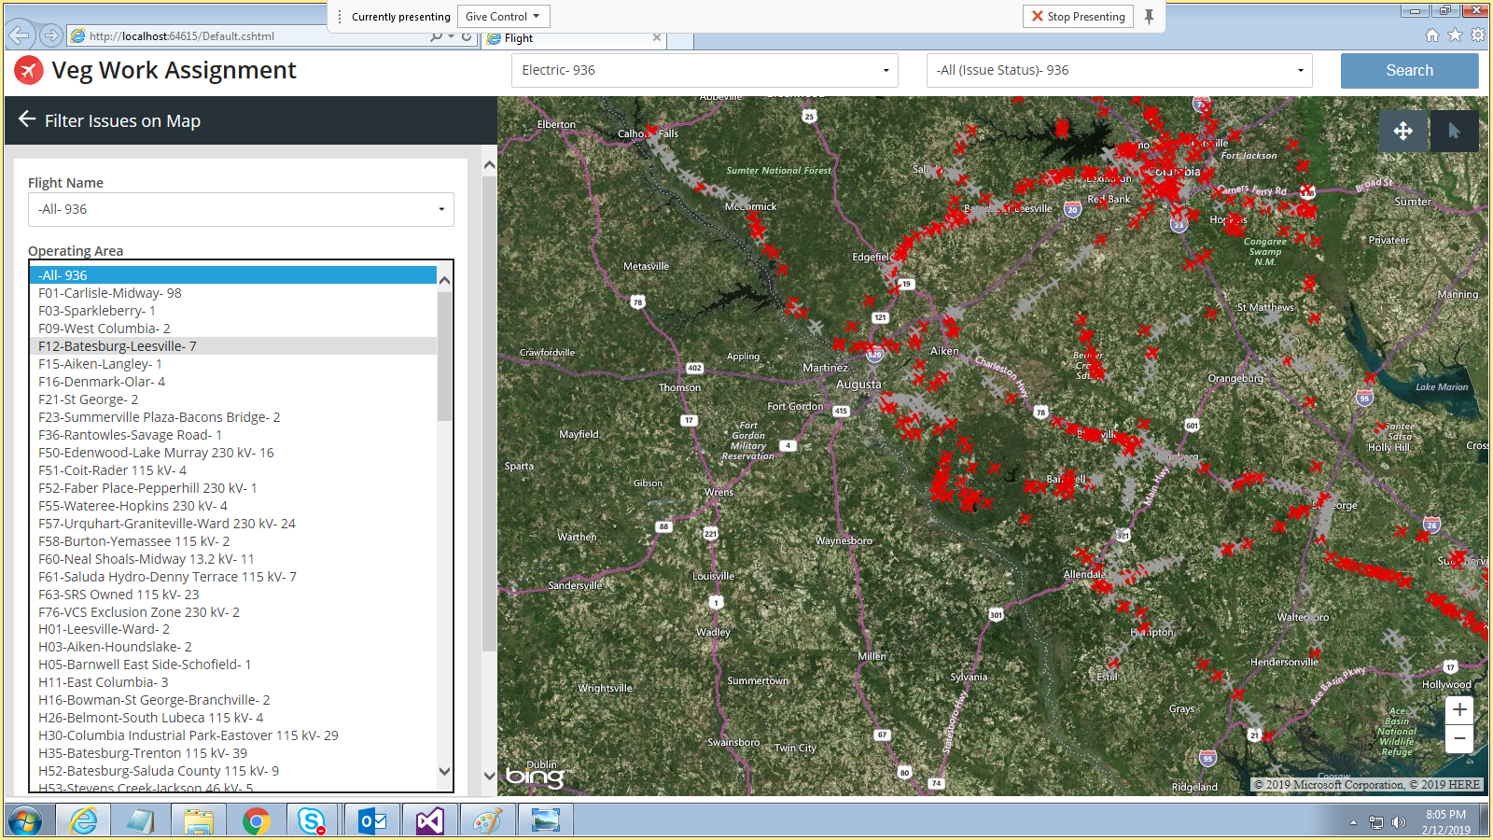
Filtering Issues by different Projects

Slide 22
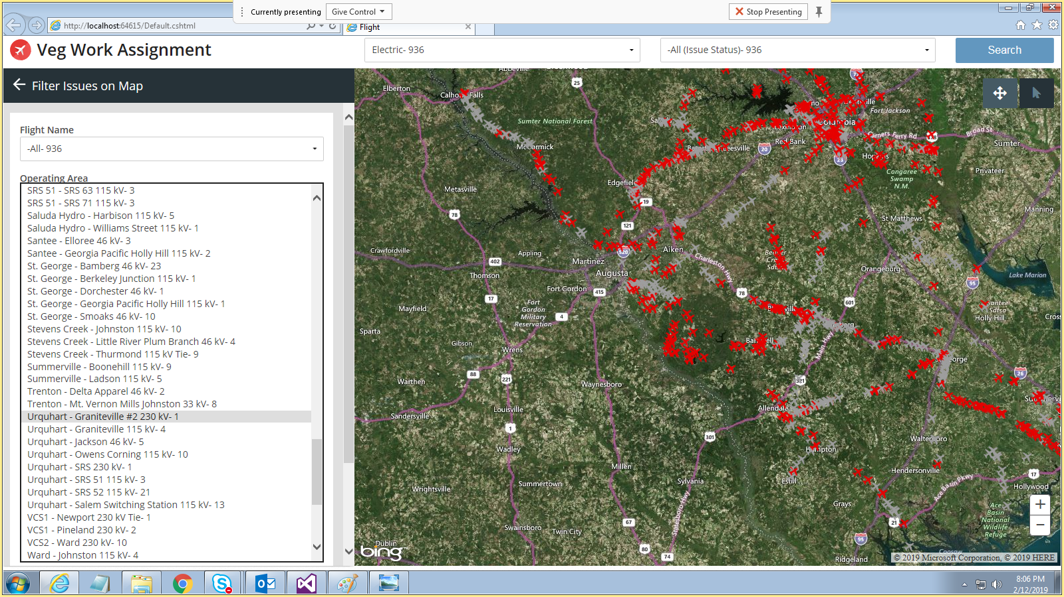
Filtering using different Line Names for a particular Project

Slide 23
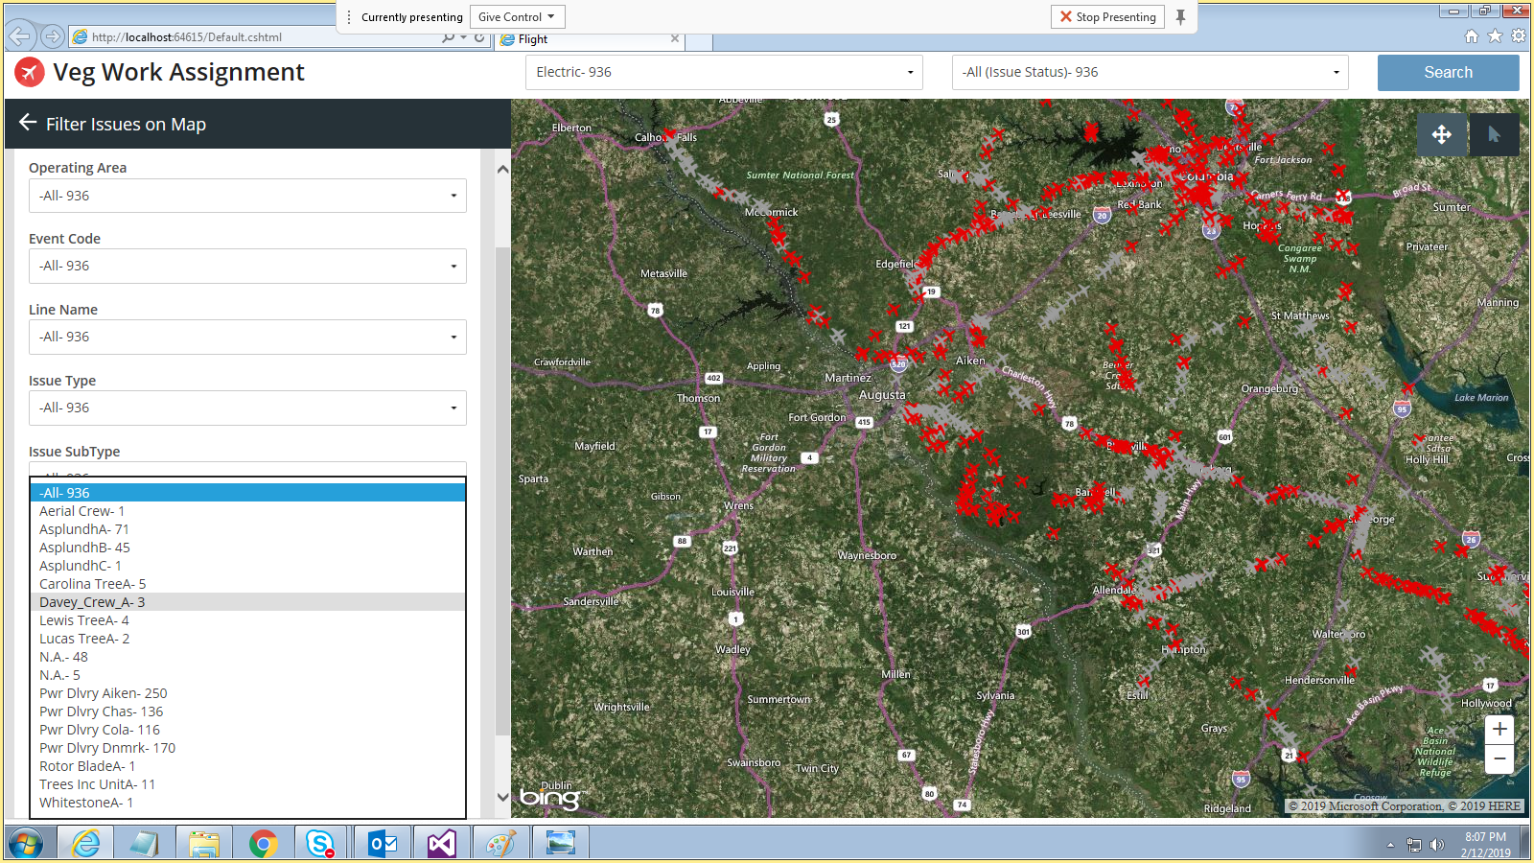
Aerial View of issues filtered by Crews

Slide 24
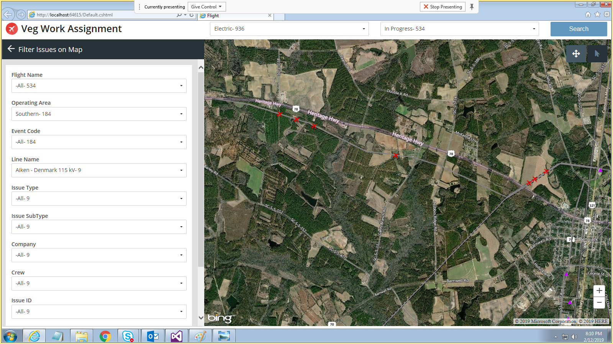
Displaying issues for a specific line name

Slide 25
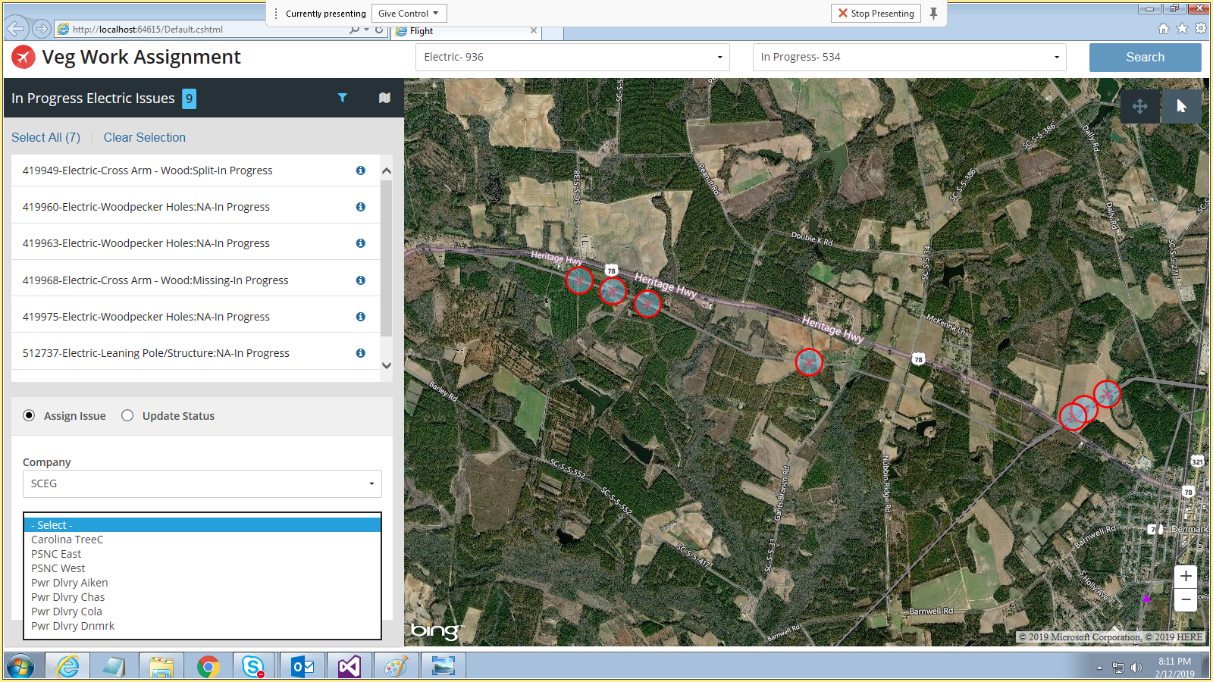
Assigning an Issue to a specific Vendor/Crew (Highlighting available Crews)

Slide 26
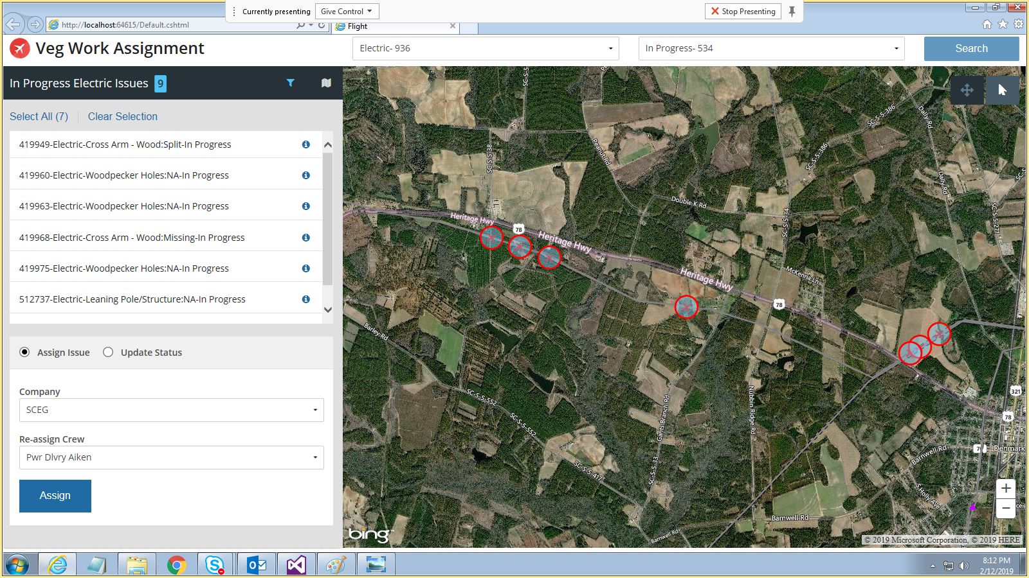
Assigning an Issue to a specific Vendor/Crew (Assigning to a specific crew)

Slide 27
Data Requirement for Electric/Land Assets
Mandatory Fields
LAT-LONG
Asset Type
All the fields on which Filter needs to be created (E.g. Project, Line Name, Region etc.)
Any other fields that PGCIL feel important to them
Optional Fields
Address related information such as City, state, PIN etc.
Name of Vendors if employed
Any date related information that PGCIL wants to be tracked
Any specifications related to the Asset (E.g. Load etc.) that is important to PGCIL
Any ownership details for ROW

Slide 28
Data Requirement for Issue Management
Mandatory Fields
LAT-LONG
Asset Type
Type of Issue
All the fields on which Filter needs to be created
Any other fields that PGCIL feel important to them
Optional Fields
Who created the issue
Name of Vendors if employed to resolve the issue
Any date related fields (Creation date, Resolution Date etc.)
Any ownership details for ROW
History of how last few ROWs issue were resolved

Slide 29
Value Proposition to PGCIL from this POC
Centralized system to manage different type of issues in a real time mode.
MAP based visualization makes it more effective way for addressing the challenges faced by the field personnel. It also helps the senior management to have a holistic picture of all the issues.
Smart filtering option allows us to slice/dice the data which will help in root cause analysis of any specific issue. This will help PGCIL in effective planning for issue management.
Different fields relating to the issue can be dynamically changed and assigned as desired which makes it efficient and the progress can be tracked.
Efficient resource mobilization for issue resolution results in cost reduction. This will also minimize the downtime and result in more customer satisfaction.
This application can also feed relevant data effectively to PGCIL asset management system.

Slide 30

Thank You!

